Slide 1
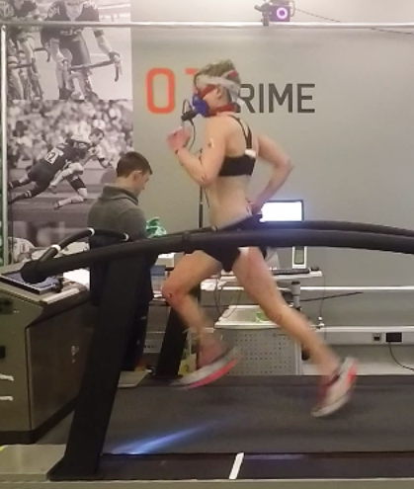
ARE YOU A FEMALE ENDURANCE RUNNER?
WE ARE LOOKING FOR FEMALES WHOM
CAN RUN 10 km in 40 – 55 min,
Are Aged 18-40 years,
Have a BMI <23
What will you gain from taking part?
Physiological assessment (measurements of VO₂ max, running economy, lactate threshold and lactate turnpoint)
Biomechanical assessment
Details of body composition, flexibility and explosive power.
You will also be reimbursed £30 for your time/travel
For further details please contact us at: idealrunningstudy@lboro.ac.uk

